Slide 1
The Front-Line Initiative
A Regional Police Mental Health Collaborative

Slide 2





What is the Front-Line Initiative?
We are a regional police mental health collaborative consisting of the police departments of Tewksbury, Billerica, Chelmsford, Dracut & Tyngsborough along with Beth Israel Lahey Health Behavioral Services and other community partners.
Our Commitment:
To serve Our communities and provide direct connection to behavioral health and substance use services in a whole-person, trauma-informed way. Our focus is on supporting you the community; Our approach to this is three tiered: prevention, crisis response, and recovery. Our programming in these key areas provide access to clinical staff, peer support, and educational opportunities to all members of the communities we serve regardless of insurance, socio-economic status, gender identity, sexual preference, age, race, and there is not a requirement that you are police involved.

Slide 3
A Brief History
Partnership formed in 2016 between Tewksbury, Billerica, Chelmsford & Dracut to form a Pre-Arrest Jail Diversion Program
Partnership formed in 2016 with Beth Israel Lahey Health Behavioral Services to provide access to master's level crisis clinicians imbedded with Police Departments
2016/17 Received DMH Funding for a Full-Time Co-Response Master’s Level Clinician
2018 Launched data driven co-response across all towns
2019 Received Expansion Funding from Bureau of Justice Assistance to expand the innovative data-driven work being done by the departments and to expand partnership
2020 Formation of PMHC, addition of Tyngsborough, hiring of Regional Director

Slide 4
Our Services
Prevention
MHFA, CIT and Advanced Trainings for Officers
Community Trainings (Mental Health & Substance Use)
Youth Prevention
Community Outreach
Crisis Response
Pre-Arrest Jail Diversion Program
Co-Response w/Officers (soon expanding to have 2 clinicians)
Recovery Support
Peer Support
Recovery Coaches (Substance Use)
Clinical Interns (LADC, LMHC, LCSW)
MH Peer Specialist (coming soon!)
What can the Clinician assist with?
Provide crisis psychiatric evaluation
Create a safety plan
Work with Outpatient Providers
Create referrals for services
Assist with de-escalation
Assist with determining best course of action for criminal vs hospitalization
Provide ongoing short-term “bridge” therapy
Provide intensive Care Coordination/Case Management Services

Slide 5
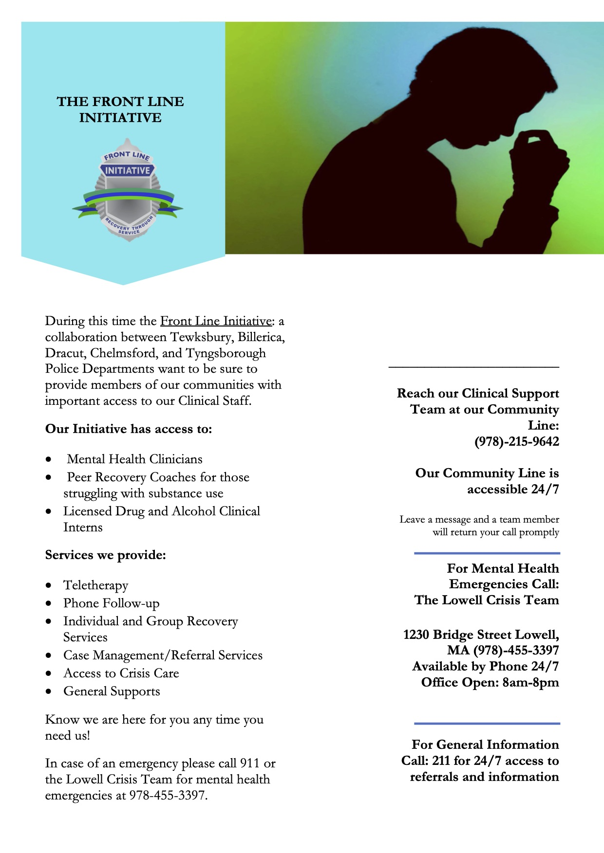
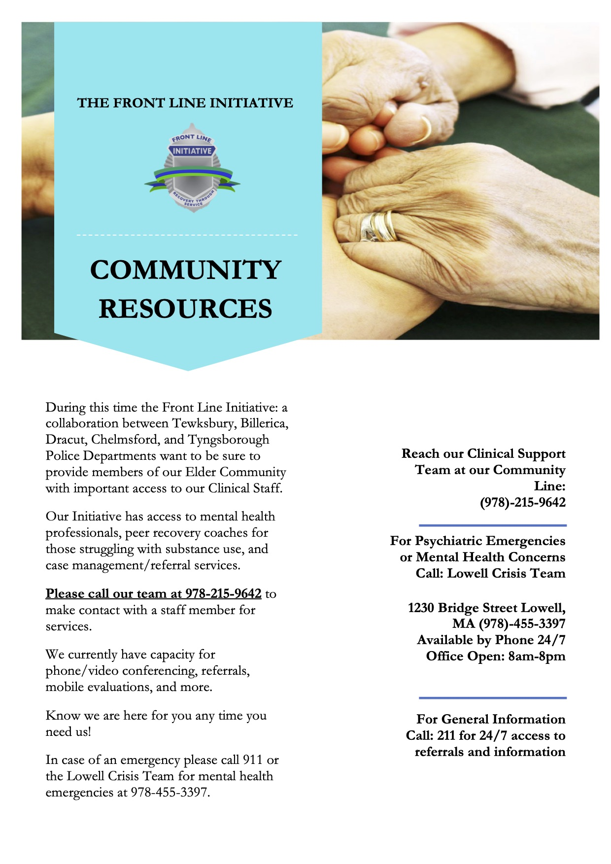
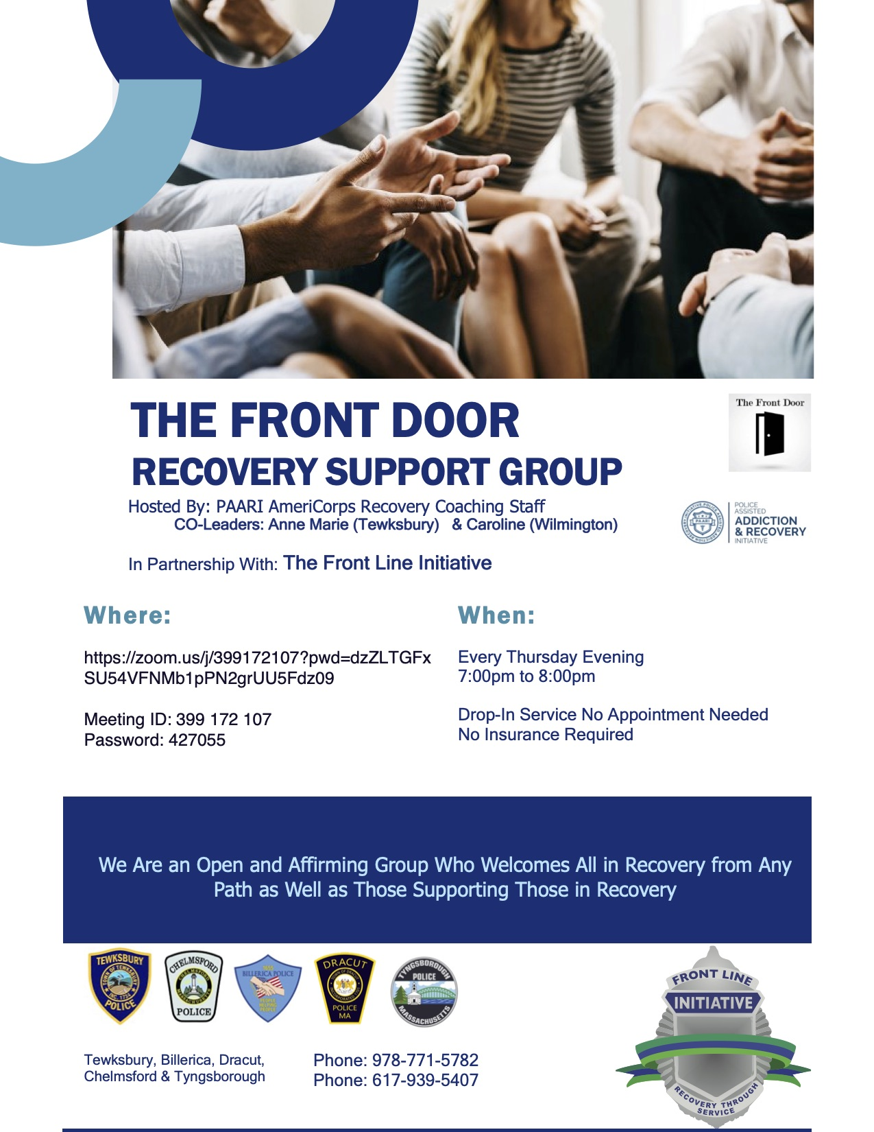
Services During COVID

Slide 6
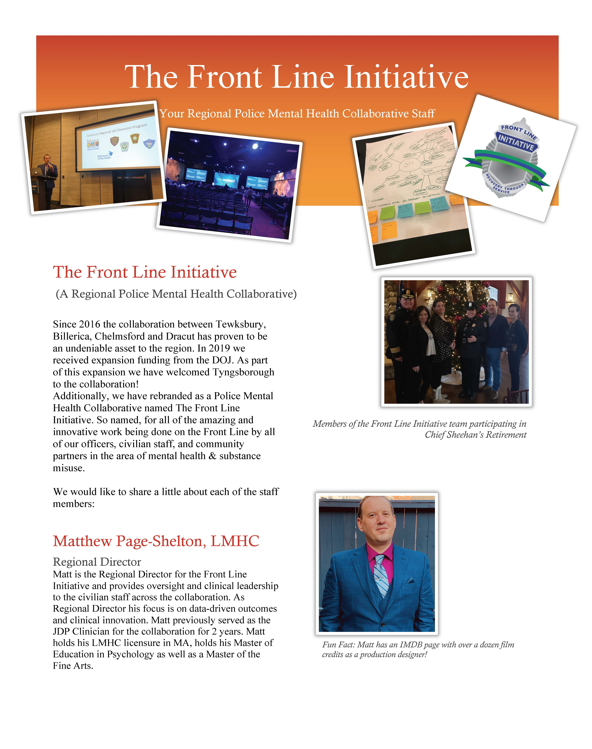

Our Clinical Staff
Maria Ruggiero- Regional Prevention Coordinator
Katlynn Bell- Co-Response Clinician
Anne Marie Yastrzemski- Recovery Coach (PAARI)
Leanne Maniscalco- Recovery Coach (PAARI)

Slide 7
Our Work by the Numbers
Since 2018 we have had:
3,274 Referrals for Co-Response Outreach
812 Emergency Room Diversions
444 Criminal Charge Diversions
ER Diversion & Criminal Custody Diversion Cost Savings:
(Amounts based on estimates established by Advocates JDP TTAC Center of $4000 per ER, and $2500 per Criminal Custody diversion.)
ER Diversion: $3,248,000
Criminal Custody Diversion: $1,110,000
Total Cost Savings Since 2018: $4,358,000
70% of cases where charges were possible ended with the person served receiving appropriate Mental Health/Substance Use treatment.

Slide 8
Current Projects
Wrap-Around Services for those in our communities struggling with opioid use via our work with BSAS funding in collaboration with the City of Lowell and the Town of Wilmington
Removing barriers to treatment via our work with transportation initiatives and others
Creation of a local Crisis Intervention Training (CIT) for Officers in the Greater Lowell Area
Expansion of clinical offerings via telehealth, use of LADC clinicians, and expanding Co-response Clinicians

Slide 9
How to Contact Us For More…
Community Support Line: (978)-215-9642
Regional Director, Matthew Page-Shelton:
E- mpage-shelton@tewksbury-ma.gov
Facebook: FrontLinePMHC
Twitter: @Front_Line_PMHC
Instagram: Front_Line_PMHC

