Slide 1

Town of Tewksbury Battery Energy Storage System (BESS) Proposal
What is the approval process and what is the Town’s role in that process.
What has the Town done to date?
What steps is the Town taking to protect the Health and Safety of the Town and its Residents?

Slide 2
What is the Permit Process for a Battery Energy Storage System? Why the Energy Facility Siting Board (EFSB) is the siting authority
MGL Chapter 40a, Section 3 intends that if a proposed use of land or structure is reasonably necessary for the convenience or welfare of the public it can be exempted from local zoning oversight through a petition to the Energy Facilities Siting Board (EFSB)

Slide 3
What is the Permit Process for a Battery Energy Storage System? Public Hearing
The EFSB acts as the fact finder and approves the project based on evidence presented during the process.
EFSB initially conducts a public hearing usually within the community affected (This project’s hearing was held at TMHS on October 9,2025).

Slide 4
What is the Permit Process for a Battery Energy Storage System? Petition to Intervene
Persons or groups who wish to be involved in a Siting Division proceeding beyond providing public comments at the hearing may seek either to intervene as a party, or to participate as a limited participant.
The Town has petitioned as an Intervening Party
Dennis Sheehan and Maureen DiPalma of Emerald Court have petitioned as an intervening party.
Greg Corbin of Emerald Court has petitioned as a limited participant in the process.
It is anticipated that the BOH of Tewksbury may also be excepted as a late intervening party.

Slide 5
What is the Permit Process for a Battery Energy Storage System? Discovery
The developer or utility company responds to written questions (called "discovery") from the Siting Division staff and individuals or groups that have been permitted to intervene as a party. Intervenors may present expert testimony, if they wish to do so. They may also be requested to respond to discovery by the developer or utility company and the staff, and may be required to respond to discovery by other intervenors.
The Town intends to submit questions and use experts to assist and supplement the inquiries made by the Town. (Stormwater, noise, Fire Safety, Environmental Concerns)

Slide 6
What is the Permit Process for a Battery Energy Storage System? Evidentiary Hearings
Witnesses are questioned under oath by Siting Division staff, the developer or utility company, and intervenors in a process that resembles a hearing in a court of law.
Briefs
The developer, intervenors and, in some cases, limited participants provide written arguments as to why the evidence indicates that the proposed project should or should not be approved.

Slide 7
What is the Permit Process for a Battery Energy Storage System? Issue Decision or Order
For proceedings under EFSB jurisdiction, the Siting Division staff issues a Tentative Decision approving or rejecting the project. The parties receive the Tentative Decision prior to the scheduled Siting Board meeting for review and comment. After the comment period, the Siting Board meets in public to vote on whether to accept the Tentative Decision. The Final Decision reflects any changes made at the Siting Board meeting.
This process is expected to take us through the Spring of 2026

Slide 8
What is the Permit Process for a Battery Energy Storage System? What is the Town’s Role?
The Town is not the permitting Authority.
The Town will participate as an intervening party and represent the interests of the Town.
The Town will use the “Host Community Agreement” tool to gain conditions and concessions that will be incorporated into the permit process.
Taking a purely adversarial position on this project will deny the Town the opportunity to incorporate safety conditions through this process.

Slide 9
What is the Permit Process for a Battery Energy Storage System? What is the Town’s Role?
The Town will continue to solicit input from:
Fire Department – Safety Police Department – Safety Engineering – Stormwater Board of Health Department – Health, Noise Public Comments and Concerns
Consultants:
Fire Safety, Legal, Property Assessors, Noise

Slide 10
What has the Town done to date with this project?
Fri 2/28/2025 10:00 AM - 11:00 AM
The Town had an initial meeting in the Town Manager’s Office with East Point Energy Meeting - Battery Storage Facility
3/04/2025
Tewksbury Select Board Introduction to Project and Hillman Energy Center, LLC
3/18/2025
Open house (Residents and Business within 0.5 Miles invited) 500 Properties. Roughly 50 residents attended Introduction to Project and Hillman Energy Center, LLC

Slide 11
What has the Town done to date with this project?
Thu 4/3/2025 9:00 AM - 11:00 AM Stand alone battery storage site visit in North Reading
Thu 4/3/2025 1:00 PM - 2:00 PM Battery Storage Facility Discussion [In-person] with Representatives from Emerald Court.
Thu 6/26/2025 10:00 AM - 11:00 AM Meeting with Emerald Court Trustees
Thu 10/16/2025 Board of Health Presentation by MAHB regarding BESS Facilities and voted to set up a site assignment hearing for the BESS proposal.

Slide 12
What has the Town done to date with this project?
Thu 10/29/2025 Rescinded Site Assignment hearing and Scheduled Today’s Informational Session with intent to file as an intervening party.

Slide 13
BESS Safety Standards and Regulations NFPA 855 vs. UL9540
NFPA 855 – Standard for the Installation of Stationary Energy Storage Systems
NFPA 855 provides the installation, siting, spacing, fire protection, and emergency response requirements for BESS. It is the primary code that dictates how systems must be designed and placed to minimize fire and explosion risks.

Slide 14
BESS Safety Standards and Regulations NFPA 855 vs. UL9540
UL 9540 – Energy Storage Systems and Equipment
UL 9540 is a system-level safety certification. It evaluates an energy storage system as a whole (battery modules, enclosures, BMS, inverters, thermal controls) to confirm it meets established safety performance criteria.

Slide 15

BESS Safety Standards and Regulations UL9540A
UL 9540A – Test Method for Evaluating Thermal Runaway and Fire Propagation
UL 9540A is a destructive testing method that measures how a system behaves during thermal runaway, including fire spread, gas production, heat release, and explosion potential. It provides the scientific data needed to justify safety distances, venting, and mitigation.

Slide 16
BESS Safety Standards and Regulations Fire Departments Use these Standards to:
Require NFPA 855 compliance documentation for site layout, separation distances, detection systems, fire suppression, and hazard mitigation.
Require proof of UL 9540 certification for the exact system being installed.
Require UL 9540A test reports to validate proposed separation distances, venting strategies, and protection against thermal runaway.
Ensure that the system design addresses fire department access, roadway clearance, staging areas, and fire lanes.
Essentially NFPA 855 is the enforcing and application layer, translating UL test results into code-compliant installation and operational rules.

Slide 17
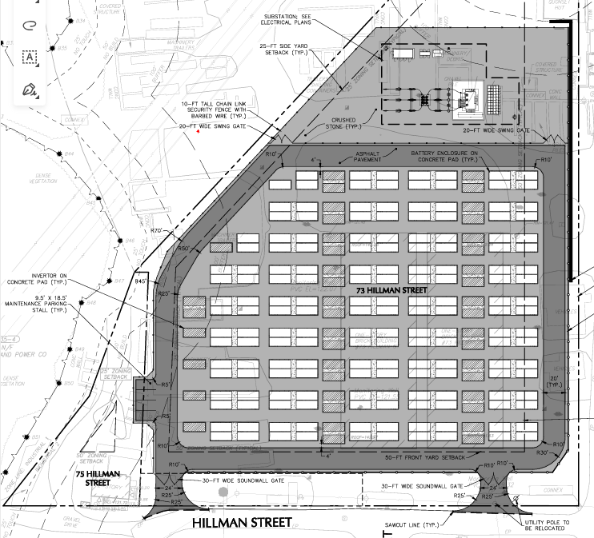
BESS Safety Standards and Regulations Determining Safe Siting and Separation Distances
NFPA 855 provides the baseline siting rules, but UL 9540A data gives the fire department the evidence to determine if:
Containers or racks need greater spacing than the minimum.
Explosion vents, gas exhaust systems, or barriers must be added.
The BESS location presents risks to adjacent homes, critical infrastructure, or community spaces.
Fire departments use these standards together to prevent fire spread, limit explosion hazards, and protect nearby properties.

Slide 18
BESS Safety Standards and Regulations Requiring Fire Protection and Detection Systems
NFPA 855 dictates what must be included, such as:
Heat/smoke/gas detection systems
BMS alarms tied to facility monitoring
Fire suppression or containment strategies
Signage, labeling, and emergency disconnects
UL 9540 and UL 9540A verify that these systems are appropriate for the specific battery chemistry and configuration.

Slide 19
BESS Safety Standards and Regulations Emergency Response Planning
Fire departments use NFPA 855 and UL 9540A data to prepare for real-world incidents by:
Determining safe standoff distances
Identifying gases likely to be released during thermal runaway
Planning evacuation or shelter-in-place triggers
Establishing on-site firefighting strategies
Training personnel in hazards unique to lithium-ion battery systems

Slide 20
Town of Tewksbury Battery Energy Storage System (BESS) Proposal
Questions

