Slide 1
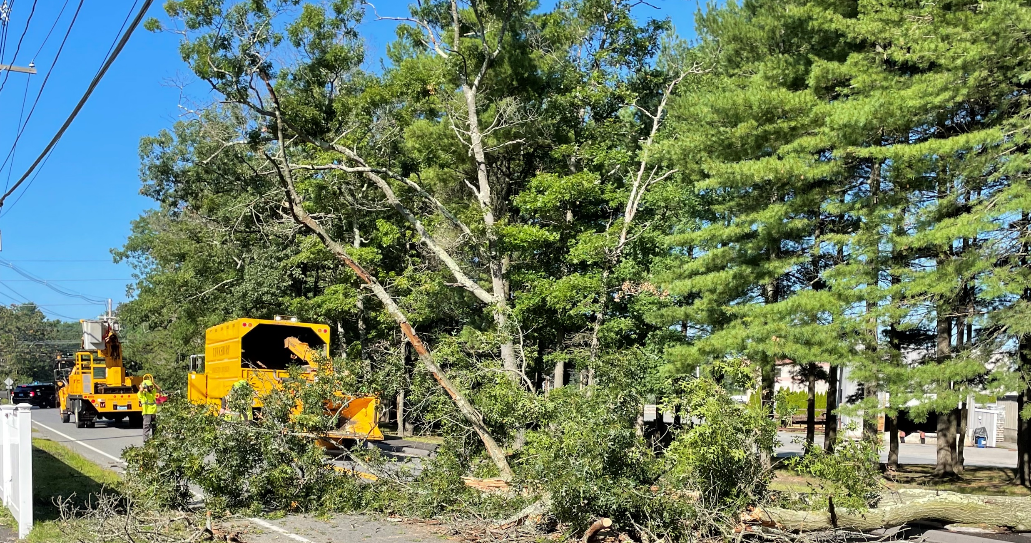
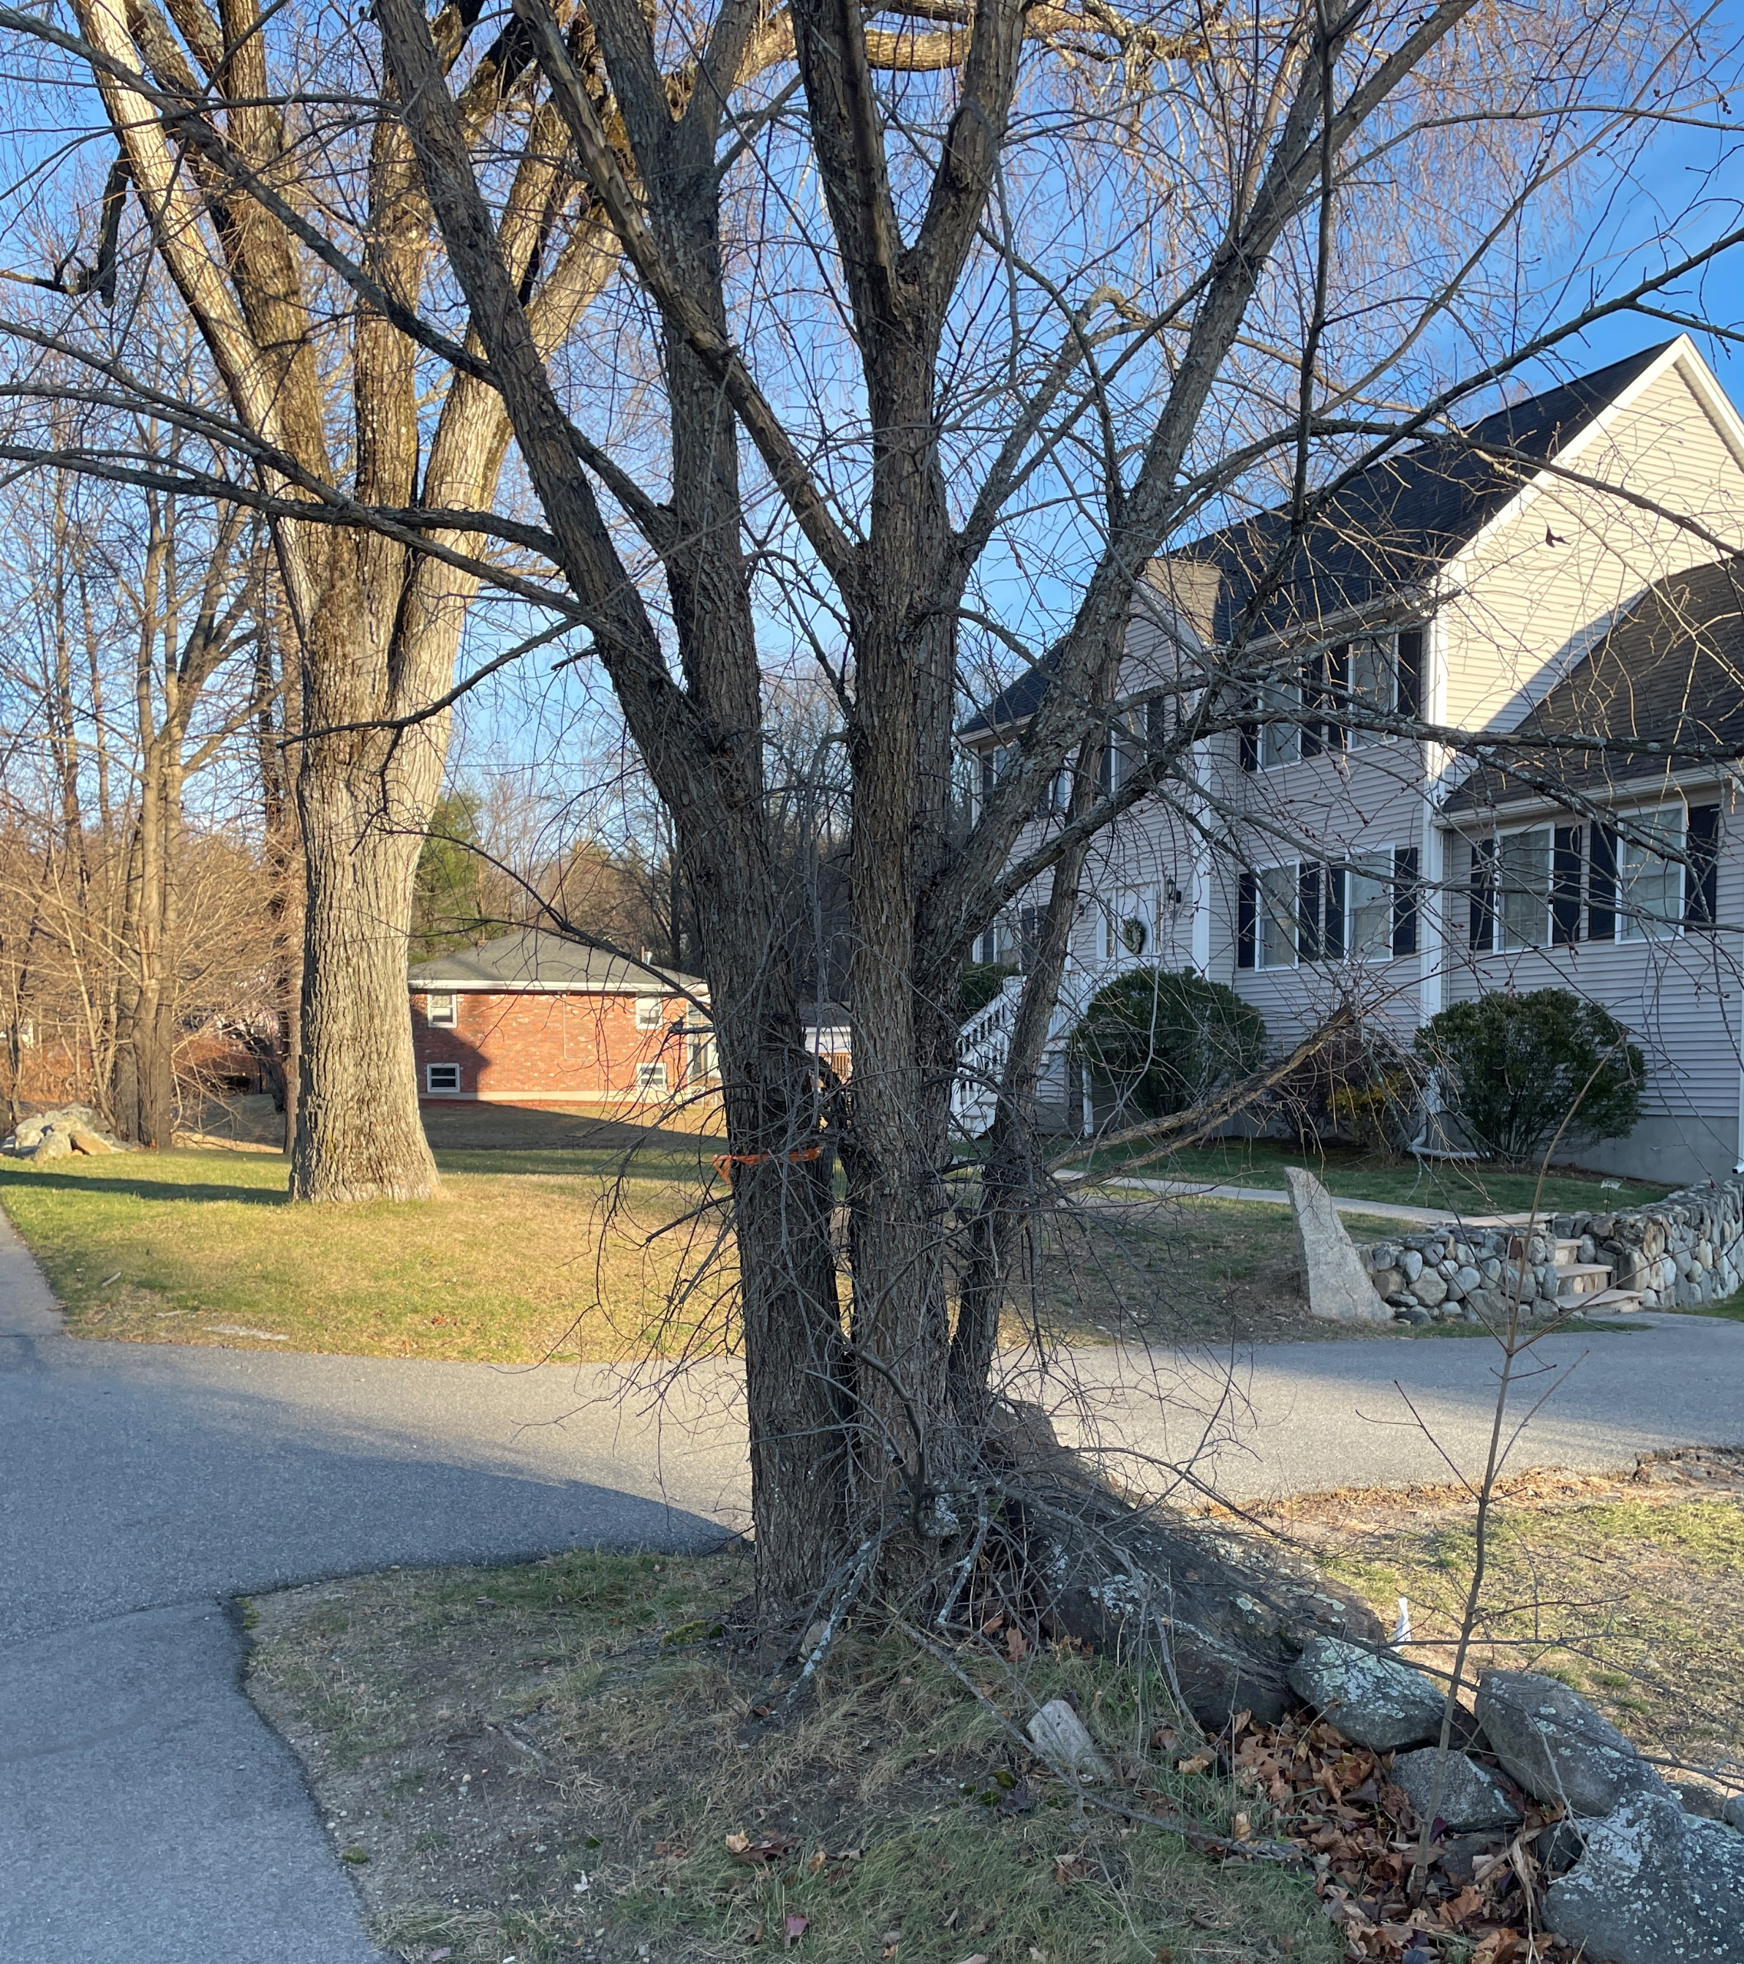
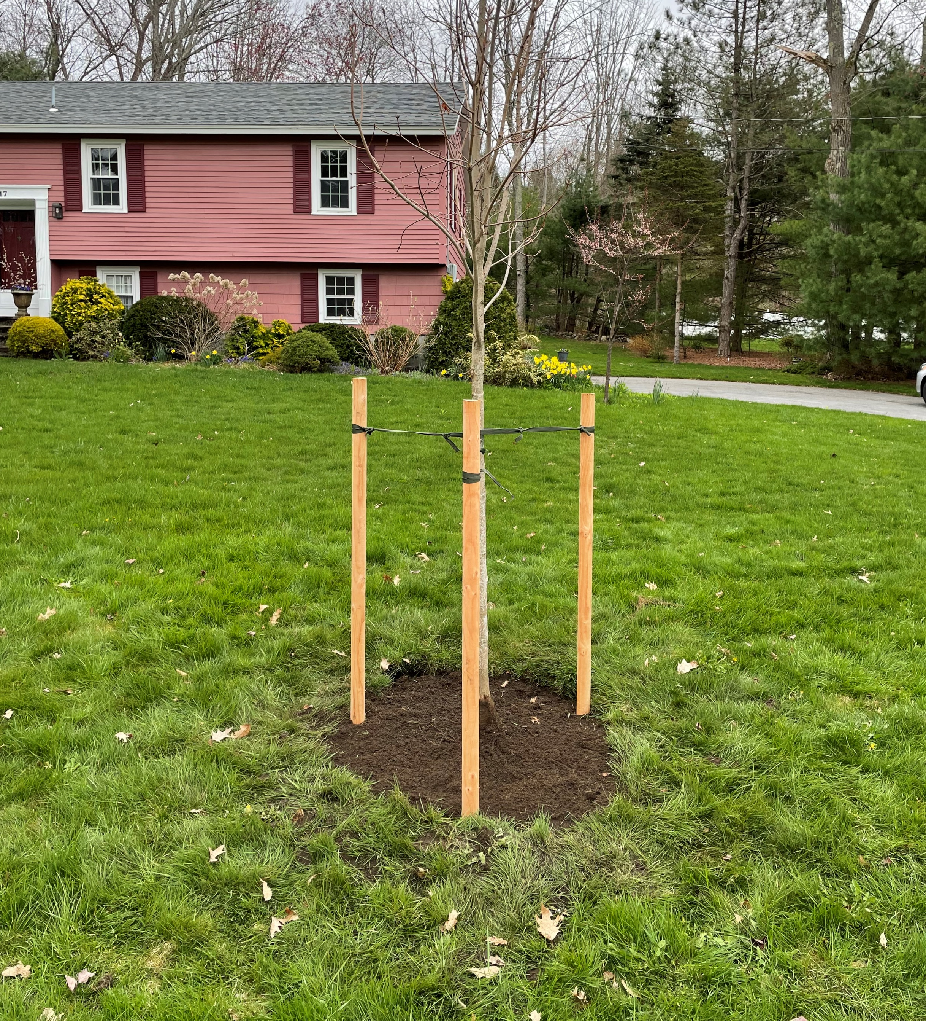
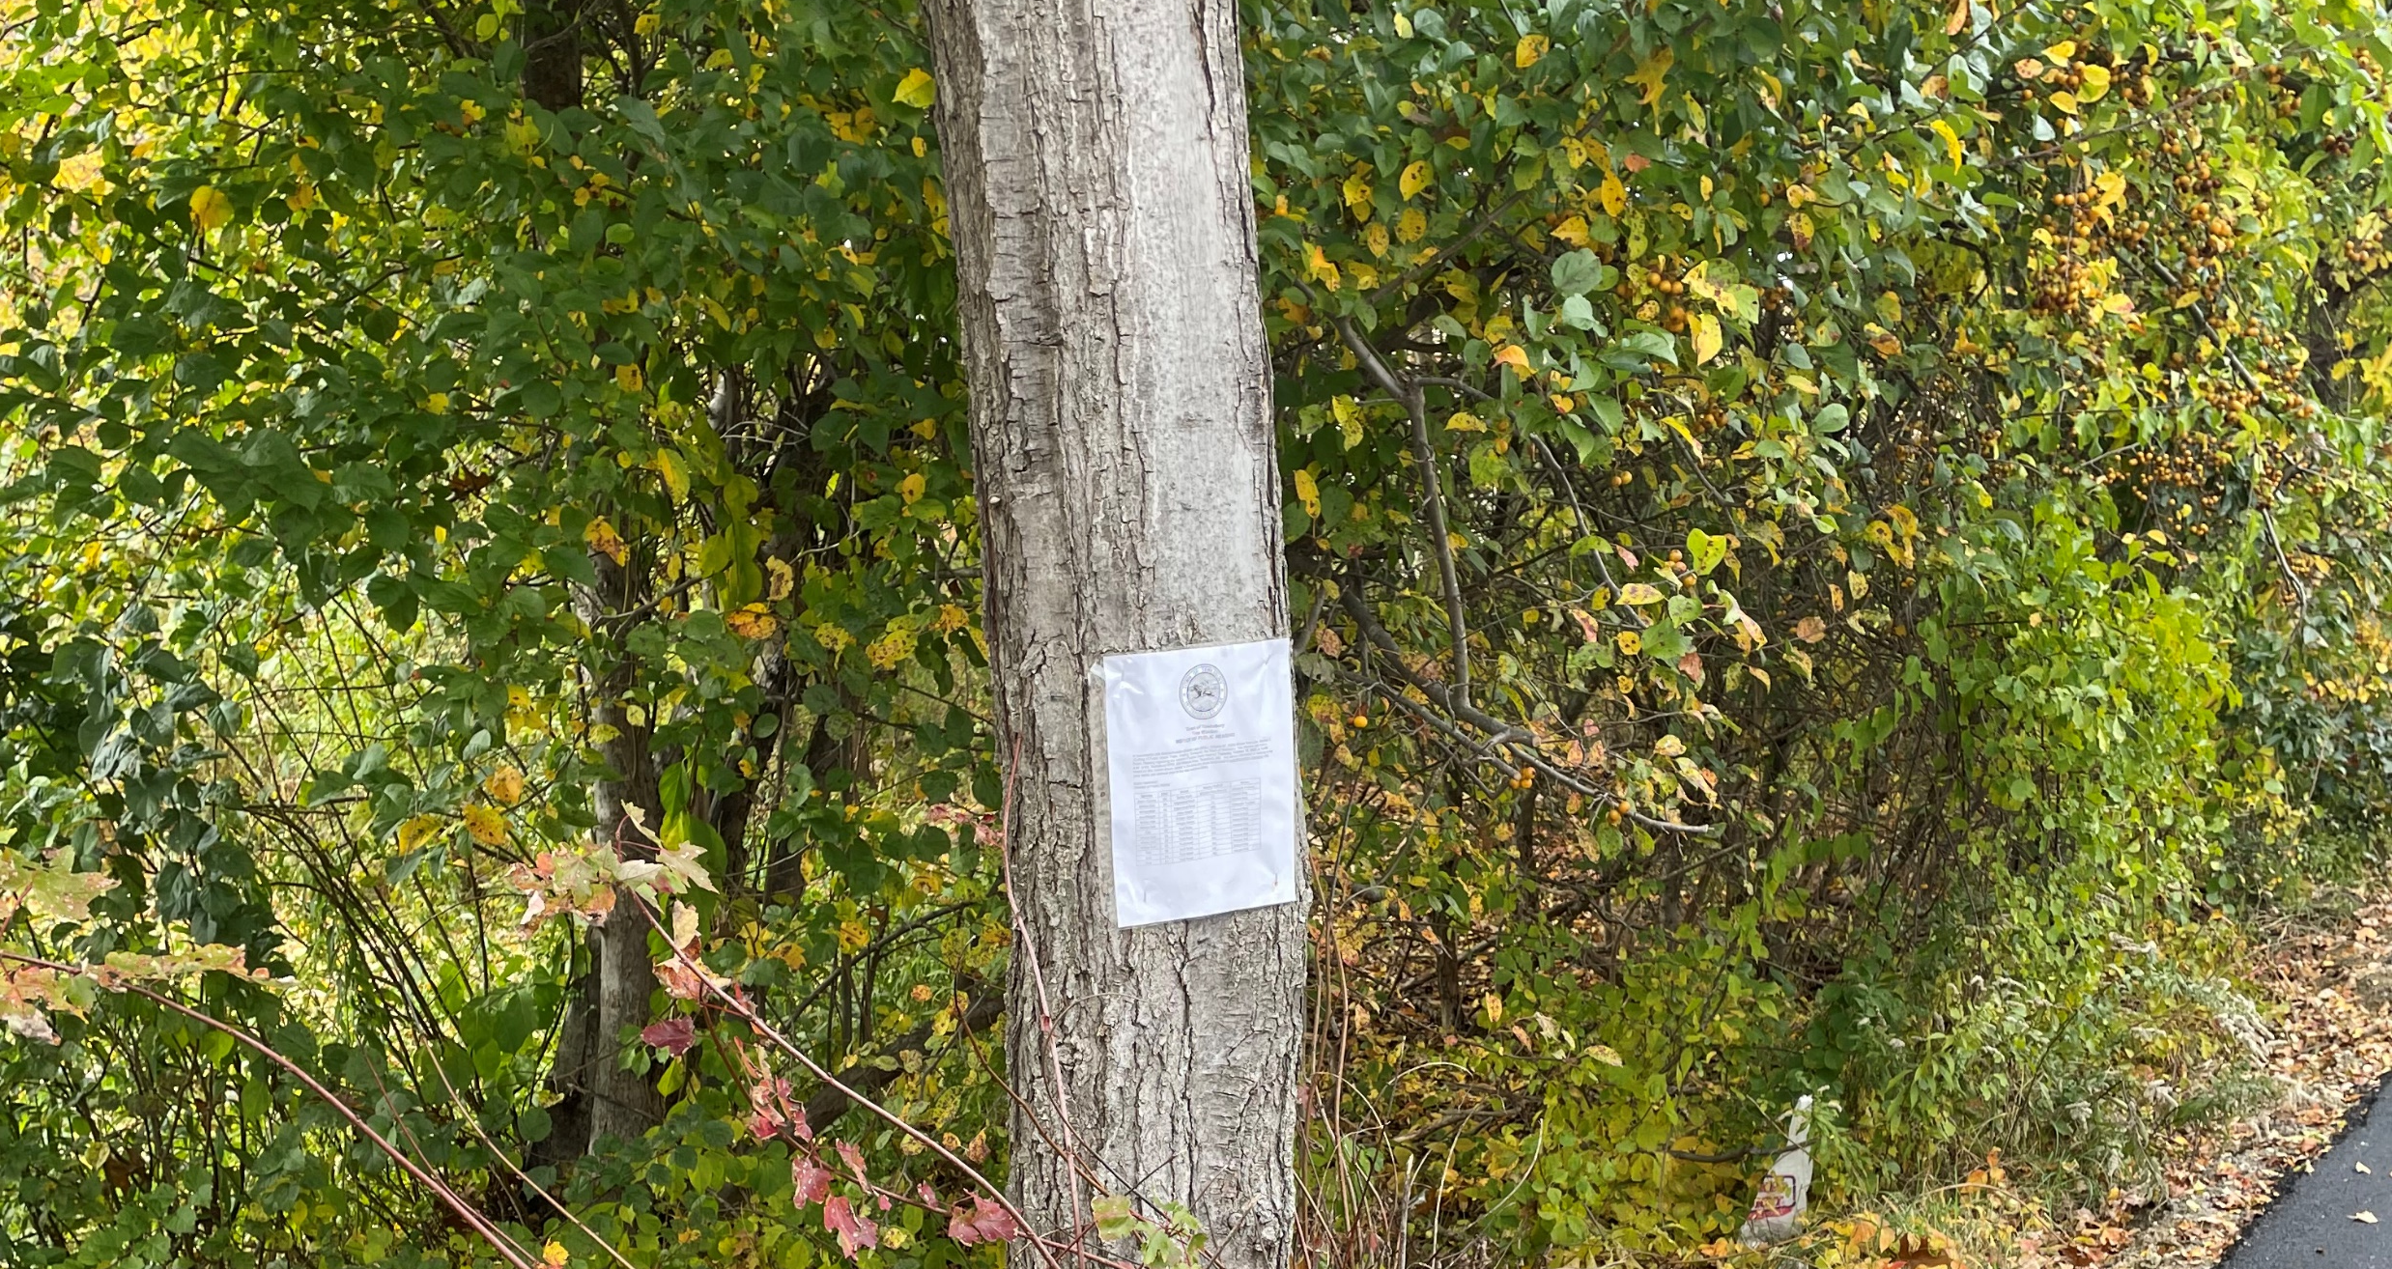
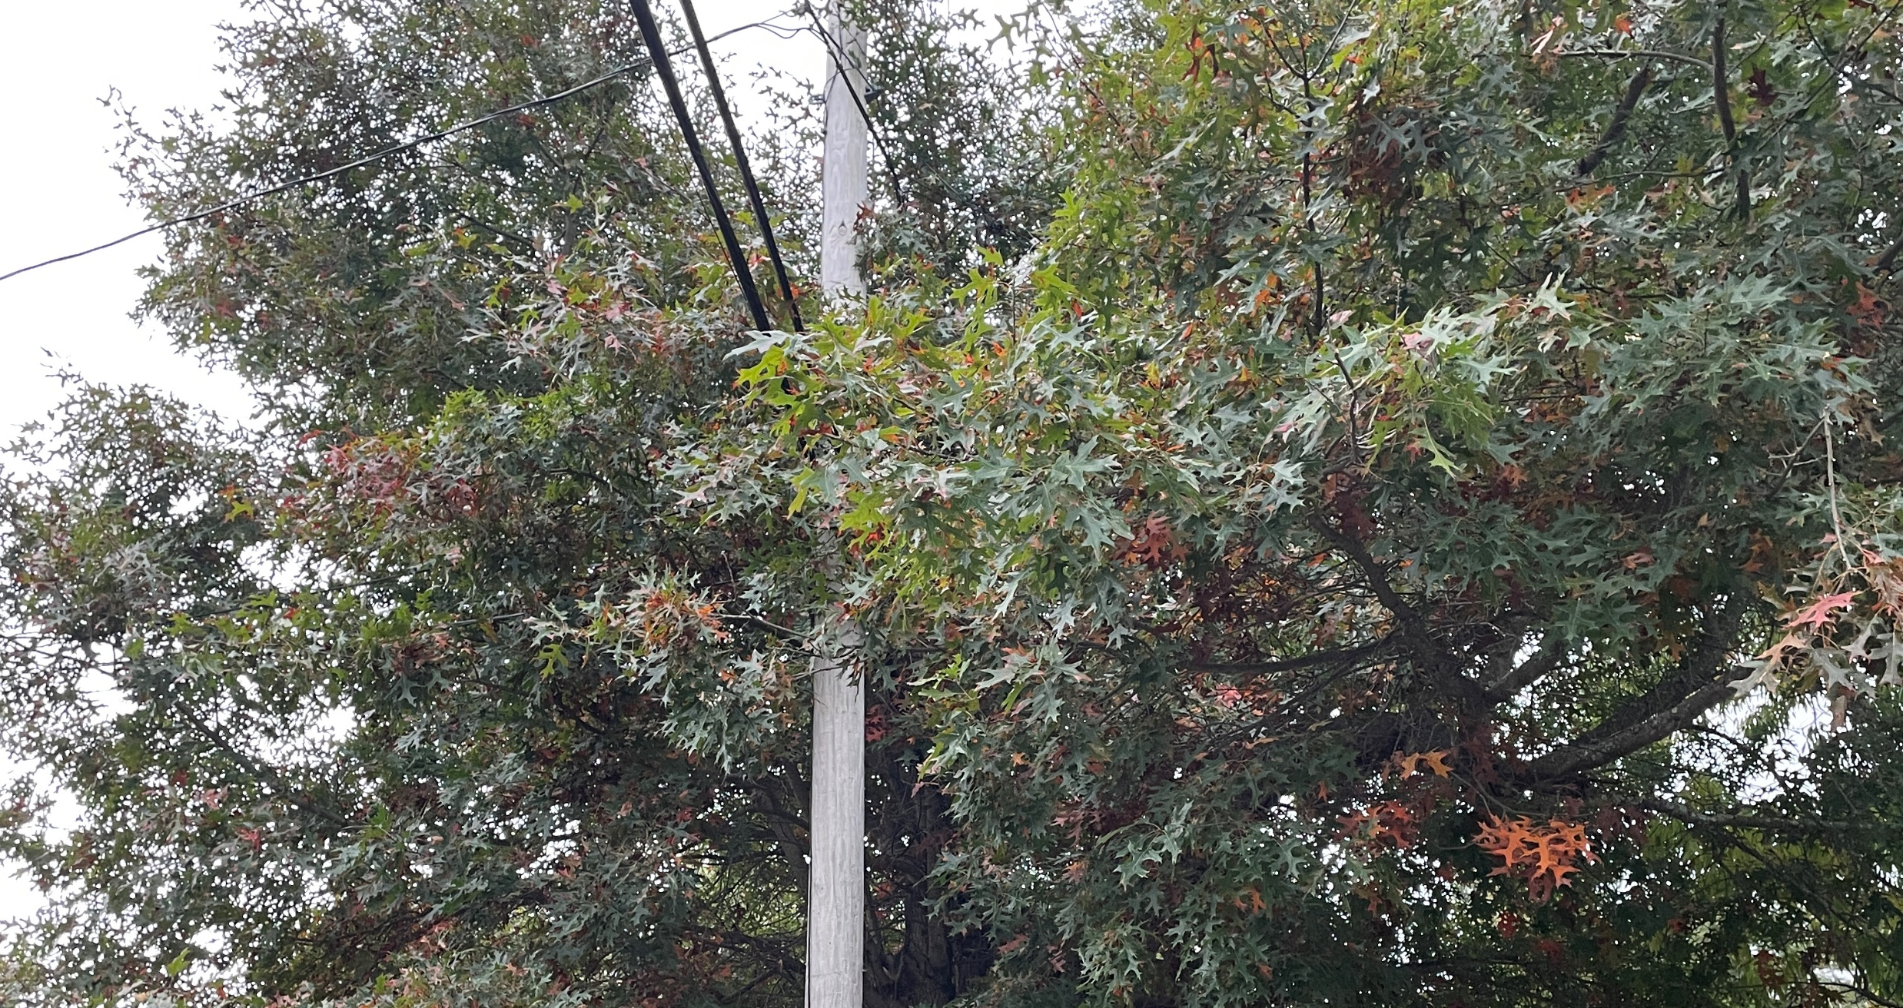

Tree Talk
Understanding Public
Shade Trees

Slide 2
Discussion Topics
Definitions
Laws, Rules, and Regulations
Homeowner & Contractor Responsibilities
Tree Removal Process

Slide 3
definitions
Massachusetts General Law Chapter 87 – The Massachusetts General Law that provides the legal protection of public shade trees.
Public Shade Tree – Any tree within a public right-of-way or on the boundaries thereof including trees planted in accordance with the provisions of Chapter 87 section 7. Trees shall have a minimum diameter of 1.5-inches one foot from the ground.
If the location of the right-of-way cannot be determined, a tree shall be considered a public shade tree until proven otherwise.
Additionally, trees planted within 20-feet of the right-of-way for the purpose of being a public shade tree shall be protected by the provisions of Chapter 87.
Right-of-Way - A right of way is publicly owned area reserved for transportation purposes.
State Highway – A roadway under the control of MassDOT.
Tree Warden – Person with the required credentials who is appointed to enforce Chapter 87.

Slide 4
Laws, rules and regulations
Massachusetts General Law Chapter 87 – The Massachusetts General Law that provides the legal protection of public shade trees.
Town of Tewksbury General Bylaw Sections 12.04.290 to 12.04.350 – Bylaw requiring police details when work is conducted in or adjacent to roadways.
Contains a list of roadways that always require police details for any work
Includes requirements for all other roadways
Work taking longer than 15 minutes, or;
Work area extends 1/3 of the travel lane, or;
Work that constitutes a safety hazard.

Slide 5
tree warden responsibilities
The Tree Warden shall oversee the implementation of M.G.L. Chapter 87 including:
Appointing Deputy Tree Wardens
Have care and control of all Public Shade Trees, shrubs, and growths in Town except:
Within a State Highway
Within Public Parks or Open Places under the jurisdiction of the Parks Commissioners
Enforce all provisions of the law for the preservation of trees, shrubs, and growths
Making Regulations for the care and preservation of Public Shade Trees
When approved by the Select Board, shall have the effect of Town Bylaws
Establishing fines and forfeitures for violations

Slide 6
Public Shade Tree Determination
The Tree Warden utilizes various resources to determine if a tree is located within the Right-of-Way and therefore a Public Shade Tree. These resources include but are not limited to:
Street Acceptance Plans
County Roadway Layout Plans
Subdivision Plans
Record Utility Plans
Certified Plot Plans for adjacent properties
Geographic Information System (GIS) Data

Slide 7
Tree removal process
When a homeowner or contractor is looking to trim or remove a tree along the Right-of-Way, they must work with the Tree Warden as follows:
Request a determination from the Tree Warden on the status of a tree as a Public Shade Tree.
A Public Hearing is required if the tree is determined to be Public Shade Tree*
*A tree hearing is not required if the tree is deemed a hazard or nuisance by the Tree Warden.
The Tree Warden shall set the date and time of the tree hearing, typically Thursdays at 10 a.m.
The Requestor shall place a Notice of Hearing in the local news paper at their expense.
Notice shall be advertised once per week for two consecutive weeks at least 7 days prior to the hearing
The Tree Warden shall provide the language for the tree hearing advertisement.
The Tree Warden shall post the same notice on the tree being requested for removal as well as two other public places in Tewksbury (DPW, Town Hall, Library).

Slide 8
Tree removal process
The Tree Warden shall hold a public hearing.
Any objections to the trimming or removal of a tree shall be provided in writing.
A tree removal can be objected to by the Tree Warden if it is felt the tree removal is not warranted
If an objection is filed, the issues is then remanded to the Select Board for final decision.
If the tree removal is approved, the Tree Warden will issue a Tree Removal Permit, which may include special conditions such as stump removal, restoration, and planting a replacement tree.
The Planning Board and/or Conservation Commission may have additional regulations based on the location of the subject tree.
Trees located within a State Highway require approval from MassDOT prior to removal.
No hearing is required.

Slide 9
violations
Chapter 87 Violations
Trimming or removal of a Public Shade Tree - Fine of not more than $500 plus damages
Posting a sign, advertisement, cuts, paints, or marks a Public Shade Tree - Fine of not more than $50
Injury to Trees of another Person - Fine of not more than $500 or imprisonment of not more than six months
Tewksbury’s imposition of fines will be based on the severity of the violation

Slide 10
Resident/contractor responsibilities
Contact the Tree Warden if you want to trim or remove any vegetation along the roadway.
The location of the Right-of-Way can vary greatly
We have found that the Right-of-Way is sometimes more than 30-feet back from the roadway
Contact the Community Development Office to see if your planned work requires any additional approval/permits
Contact the Police Department to see if a police detail will be needed for your work

Slide 11
Utility companies
Utility Companies may submit the following to the Tree Warden for approval:
An annual vegetation management plan
An annual hazard tree removal plan
The plan(s) shall be submitted at least 90 days prior to the start of work
The Tree Warden shall notify the Utility within 60 days of the Plan is approved
The approval can includes mutually agreed upon modifications
If the Tree Warden fails to respond within 60-days, the Utility can seek approval from the Select Board
The Utility Company shall notify the Tree Warden, in writing, 14-days prior to starting the work
The utility shall provide to the State Forester a copy of any annual vegetation management plan or hazard tree removal plan and a copy of the approval or denial letter from the applicable Tree Warden.

Slide 12
questions
References
Commonwealth of Massachusetts. (2025, February 25). 194th General Court of the Commonwealth of Massachusetts. Retrieved from Chapter 87: https://malegislature.gov/Laws/GeneralLaws/PartI/TitleXIV/Chapter87

